Slide 1


A Symmetric Objective Function for ICP
Szymon Rusinkiewicz

Slide 2
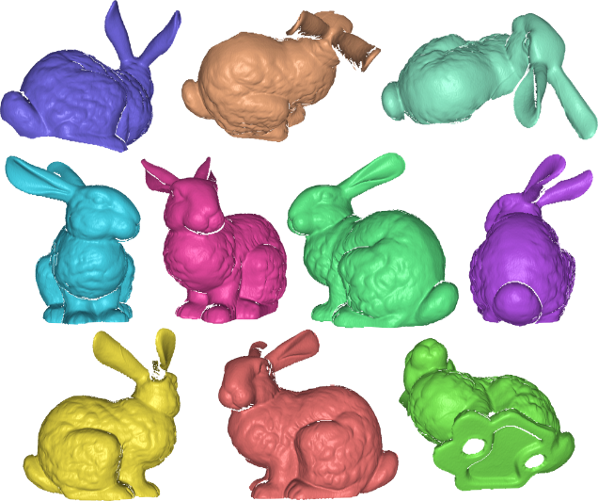
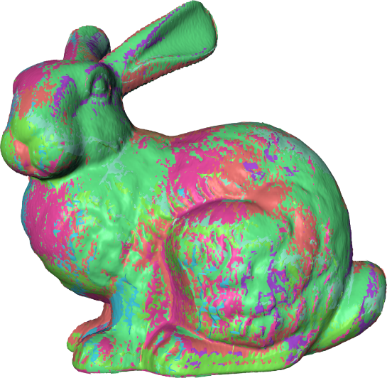
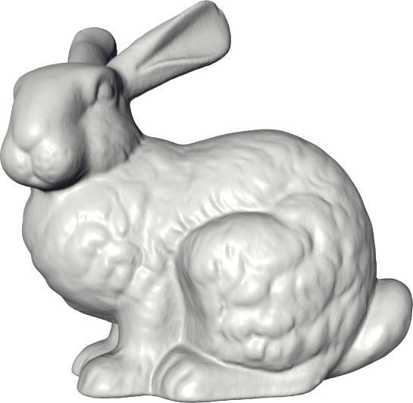
The 3D Model Acquisition Pipeline
Alignment
Merging
Raw Range Scans
3D Model
[Turk & Levoy 1994]
Notes:
At some point in the life of any young graphics researcher, it comes time to have the talk. You know the one - where do bunnies come from? This bunny actually came from a collection of 3D scans of a real-world object. But to create the final 3D model, those scans had to be aligned to each other, and then merged into a single mesh.

Slide 3
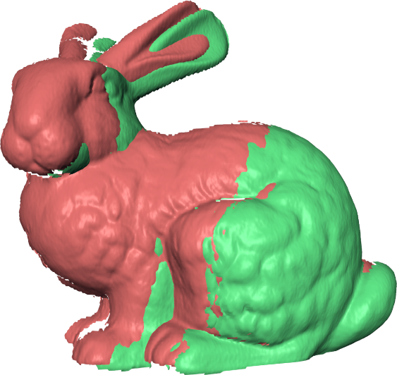
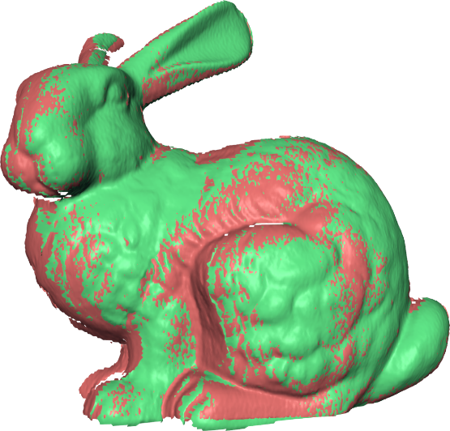
The 3D Model Acquisition Pipeline
Initial Guess
Pairwise Registration
Global Optimization
Alignment
Merging
Merging
Raw Range Scans
3D Model
[Turk & Levoy 1994]
Notes:
Actually, the alignment process is a bit more complex than it seems, with 3 separate stages involved. First, the scans have to be placed in roughly correct alignment, either manually or using a feature-matching algorithm. Second, pairs of scans are registered to each other, basically by trying to minimize the distance between them, in overlapping regions. Finally, there’s a global optimization step that tries to come up with the best alignment for each scan, that’s as consistent as possible with the pairwise alignments.

Slide 4
The 3D Model Acquisition Pipeline
Initial Guess
Pairwise Registration
Global Optimization
Merging
Raw Range Scans
3D Model
[Turk & Levoy 1994]
Notes:
In this talk, we’re focusing on just one of those stages, namely pairwise registration.

Slide 5
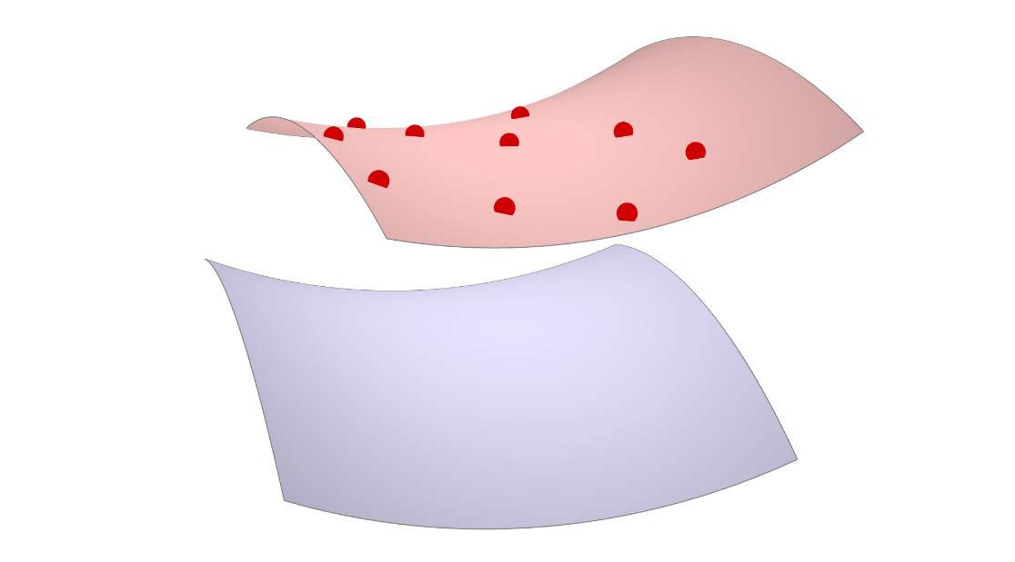
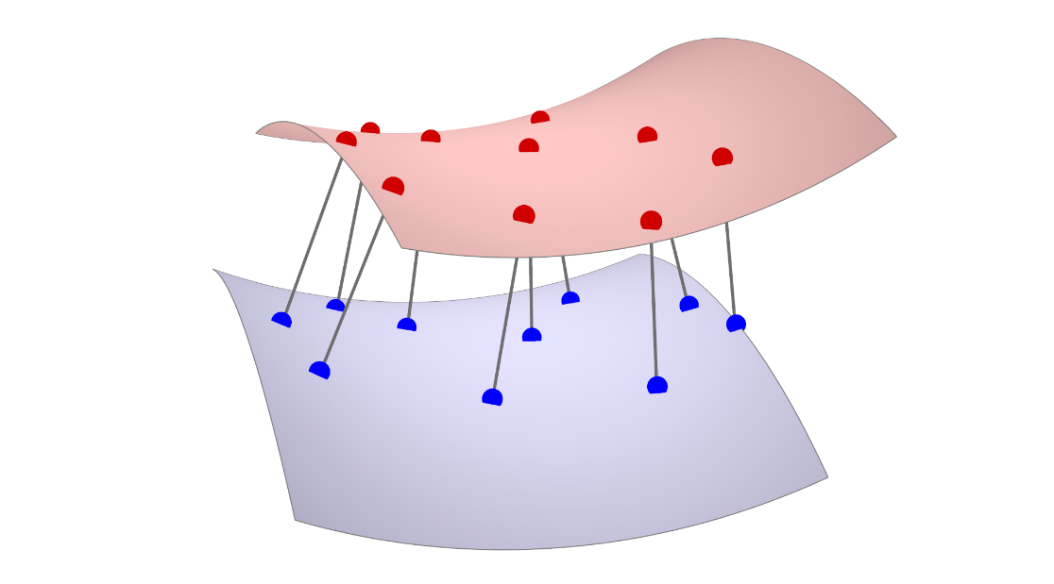
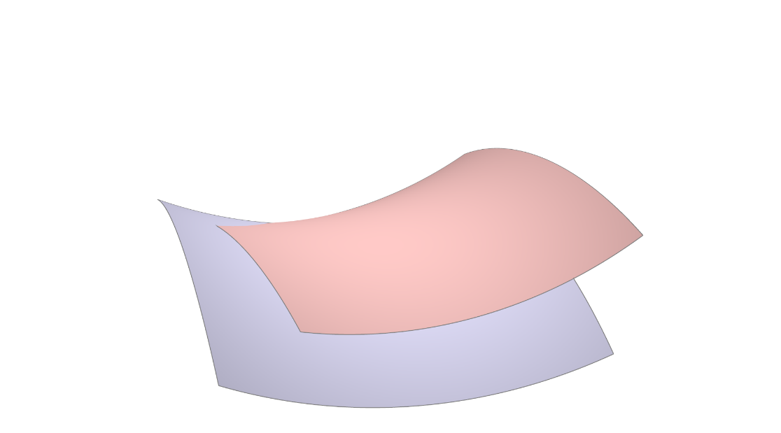
Iterative Closest Point (ICP) Algorithm for Mesh Alignment
4. Iterate until convergence
1. Select points on one mesh
2. Find closest on other mesh
3. Minimize distances
[Besl & McKay 1992]
Notes:
The algorithm that’s most commonly used for pairwise registration is called Iterative Closest Points, or ICP, and it was originally introduced by Besl and McKay. First, we pick some points on one of the two meshes, and then for each one find the closest point on the other scan. We assume that that closest point is an approximation to the correct correspondence, and imagine putting a spring that tries to pull the two points in a pair together. We minimize those spring lengths, but because the closest points weren’t necessarily the correct correspondence, we wind up with not quite the correct answer. But the process probably brought us closer to the right alignment, so now we iterate the process.

Slide 6
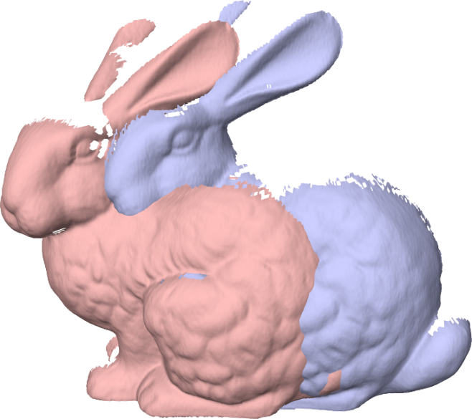
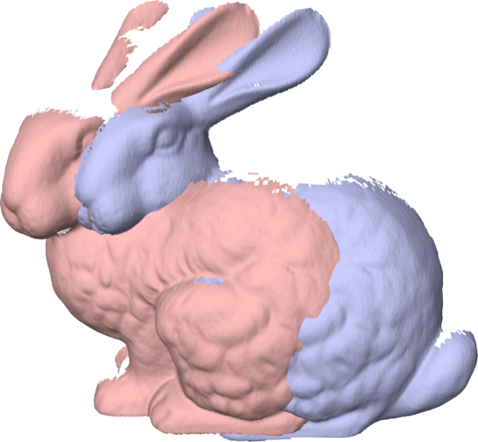
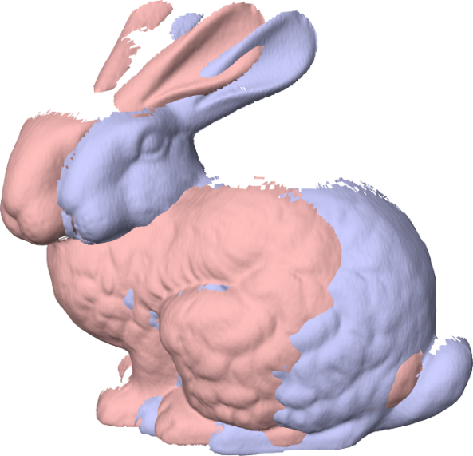
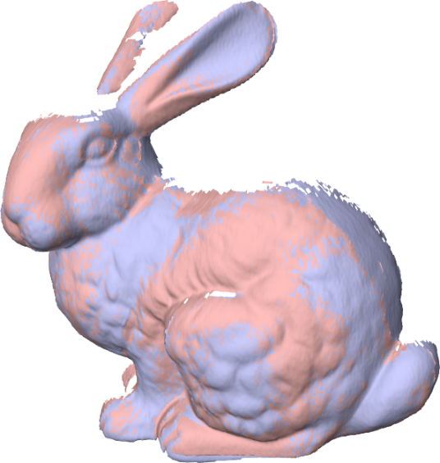
Iterative Closest Point (ICP) Algorithm for Mesh Alignment
Converges, but slowly
…
Initial Alignment
Iteration #1
Iteration #2
Iteration #100
Notes:
So, if we started with two bunny scans misaligned like this, the first iteration brought us closer, and the second iteration closer still. Finally, after a bunch of iterations we get to the correct alignment, which you can tell because the two scans in red and blue are interpenetrating. So, we see that this process converges to the right answer, given this initial alignment, but it takes a long time to do so.

Slide 7
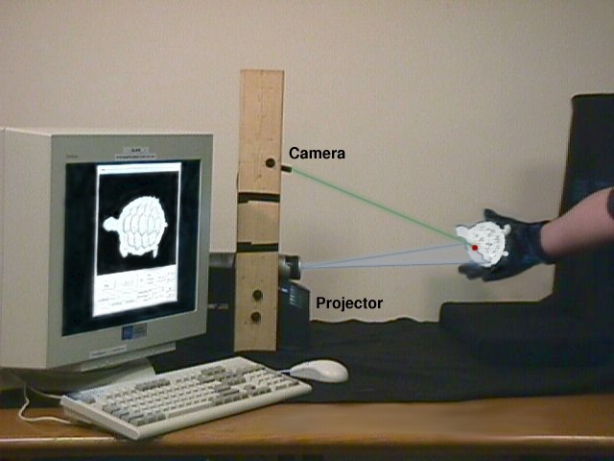
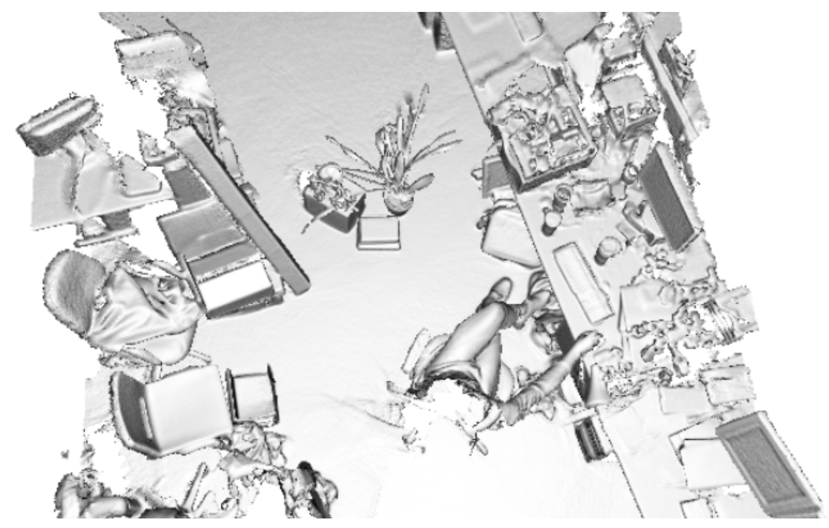
Why Worry About the Speed of ICP?
Real-time registration for interactive 3D scanning
[Rusinkiewicz et al. 2002]
[Newcombe et al. 2011]
Notes:
Why is it a problem if ICP runs slowly? One possibility is that we’re running ICP in the context of a real-time scanning system that shows the 3D model as it’s being created. In this case, we really need ICP to run in a matter of milliseconds, so that the entire pipeline can run at interactive rates.

Slide 8
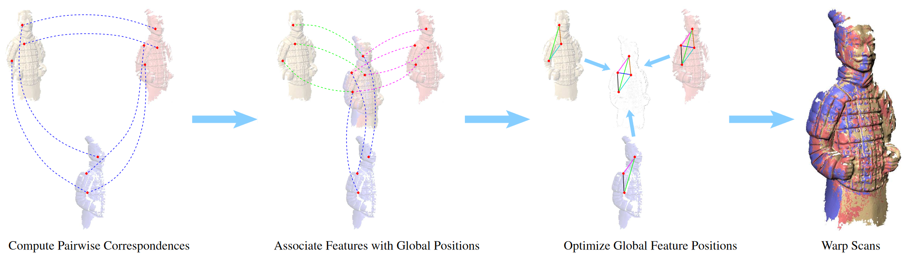
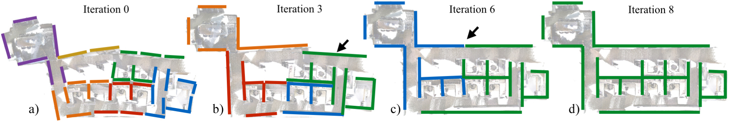
Why Worry About the Speed of ICP?
ICP in the inner loop: non-rigid alignment, fine-to-coarse refinement, etc.
[Brown & Rusinkiewicz 2007]
[Halber & Funkhouser 2017]
Notes:
Another scenario in which we really care about the speed of ICP is when it’s actually in the inner loop of some other algorithm. This might be global nonrigid registration, fine-to-coarse refinement, tracking, and so on.

Slide 9
How do we speed up ICP? How well does the method work in general? Why does it work?
Notes:
So let us ask the question of how to speed up ICP.

Slide 10
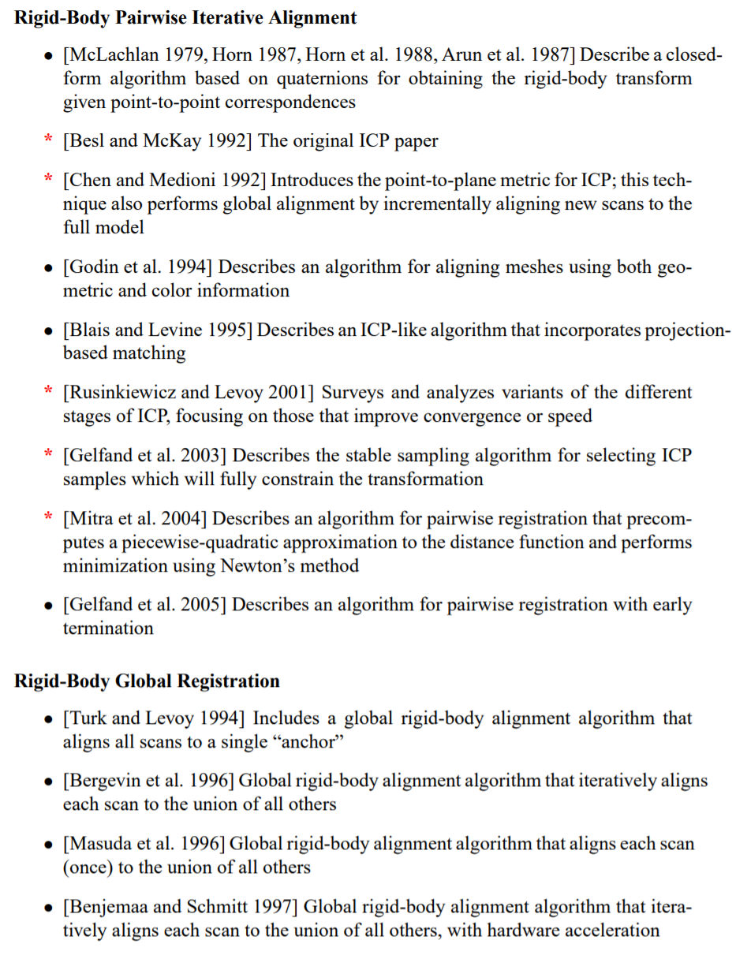
Methods for Optimizing ICP
Notes:
Unsurprisingly, this has been addressed by dozens of previous papers that have proposed better variants of ICP.

Slide 11
Organizing Methods for Optimizing ICP
Dozens of ICP variants have been proposed
They may be classified according to whether they affect:
Selecting source points (from one or both meshes)
Matching to points in the other mesh
Weighting the correspondences
Rejecting certain (outlier) point pairs
Assigning an error metric to the current transform
Minimizing the error metric w.r.t. transformation
[Rusinkiewicz & Levoy 2001]
Notes:
We can classify most of these variants as affecting one of 6 stages of the algorithm: [read the 6 stages].

Slide 12
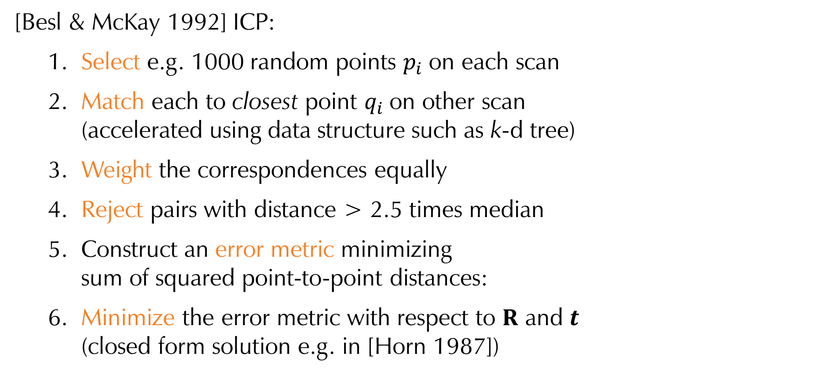
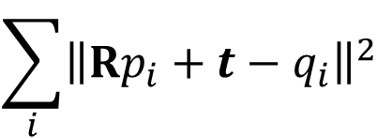
Basic Example
[Besl & McKay 1992] ICP:
Select e.g. 1000 random points $p_{i}$on each scan
Match each to closest point $q_{i}$on other scan (accelerated using data structure such as k-d tree)
Weight the correspondences equally
Reject pairs with distance > 2.5 times median
Construct an error metric minimizing sum of squared point-to-point distances:
Minimize the error metric with respect to $R$ and $t$ (closed form solution e.g. in [Horn 1987])
$$\sum_{i}{{\left\|Rp_{i}+t−q_{i}\right\|}^{2}}$$
Notes:
For example, the original Besl & McKay ICP algorithm maps to the 6 stages like this. [Read the 6 stages.]

Slide 13
This Paper
Selecting source points (from one or both meshes)
Matching to points in the other mesh
Weighting the correspondences
Rejecting certain (outlier) point pairs
Assigning an error metric to the current transform
Minimizing the error metric w.r.t. transformation
Notes:
In this paper we focus on the error metric. In other words, we’re not necessarily going to be minimizing the distance between closest points, but rather some other function.

Slide 14
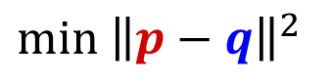
What Metric Should ICP Minimize?
Point-to-Point
$$\min{{\left\|p−q\right\|}^{2}}$$
[Besl & McKay 1992]
Notes:
So, let’s look at that metric. As we saw, in plain ICP we’re minimizing the distance between points from the two meshes.

Slide 15
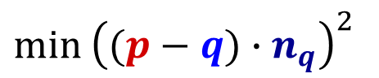
What Metric Should ICP Minimize?
Point-to-Point
Point-to-Plane
$$\min{{\left\|p−q\right\|}^{2}}$$
$$\min{{\left((p−q)∙n_{q}\right)}^{2}}$$
[Chen & Medioni 1992]
Notes:
A very common variant, introduced by Chen & Medioni, is to minimize the distance from one point to the plane containing the other point and perpendicular to its normal. It turns out that this is a common variant because it works a lot better than point to point.

Slide 16


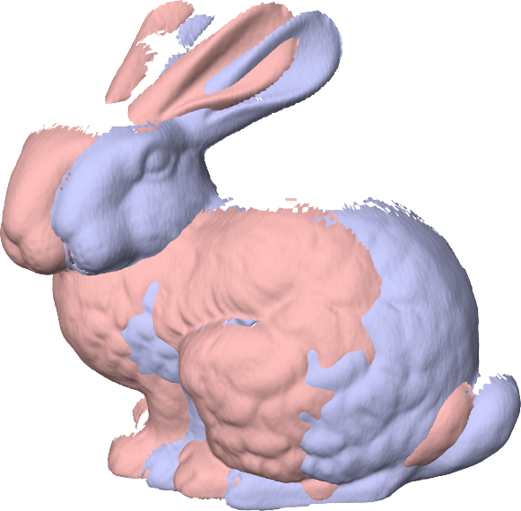

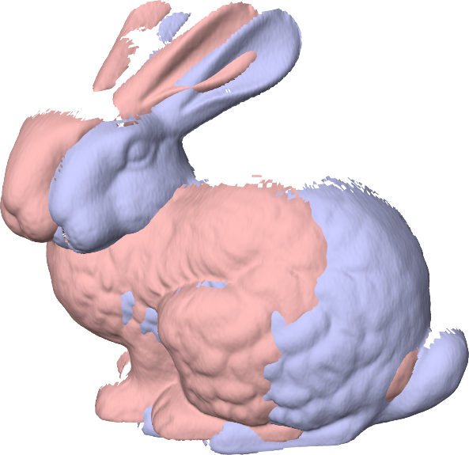
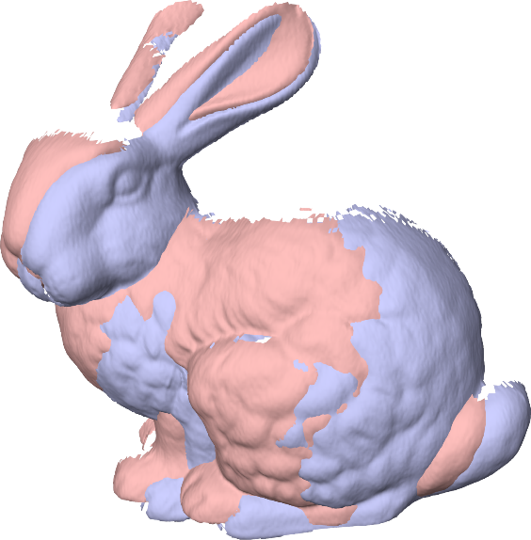
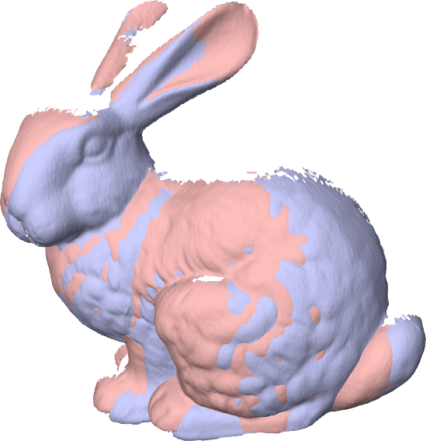
Effect of Different Metrics
Point-to-point
Point-to-plane
Initial Alignment
Iteration #1
Iteration #2
Iteration #3
Notes:
For example, starting with our misaligned bunny scans, we see that a single iteration of point to plane is already doing better than point to point. And as we go through iterations, we see that point to plane converges much more quickly.

Slide 17
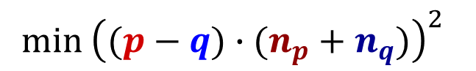
What Metric Should ICP Minimize?
Point-to-Point
Point-to-Plane
Symmetric (this paper)
$$\min{{\left\|p−q\right\|}^{2}}$$
$$\min{{\left((p−q)∙n_{q}\right)}^{2}}$$
$$\min{{\left((p−q)∙(n_{p}+n_{q})\right)}^{2}}$$
Notes:
So now, finally, we get to what this paper is about, namely replacing the point-to-plane metric with a more symmetric one that involves both normals. Basically we add the normals together…

Slide 18
What Metric Should ICP Minimize?
Point-to-Point
Point-to-Plane
Symmetric (this paper)
$$\min{{\left\|p−q\right\|}^{2}}$$
$$\min{{\left((p−q)∙n_{q}\right)}^{2}}$$
$$\min{{\left((p−q)∙(n_{p}+n_{q})\right)}^{2}}$$
Notes:
… and minimize in that direction instead of along only one of the normals. That’s basically it.

Slide 19
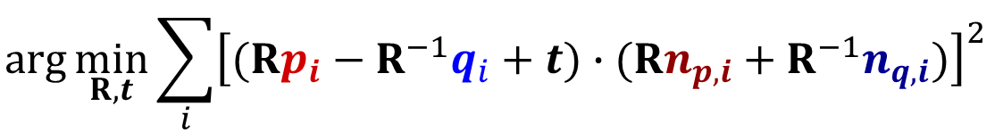
As Long As We’re Making Things Symmetric…
Symmetrize the effect of rotations:
Approximations and reduction to linear least squares (Gauss-Newton) are derived in paper
$$\arg{\min_{R,t}{\sum_{i}{{\left[(Rp_{i}−R^{−1}q_{i}+t)∙(Rn_{p,i}+R^{−1}n_{q,i})\right]}^{2}}}}$$
Notes:
Now as long as we’re making things symmetric, we might as well also make the effects of the transformation symmetric on the two meshes, so we write the error metric that we’re minimizing in a way that rotates one mesh forwards and the other mesh backwards. In the paper you can see how we make some mild approximations to reduce this to a linear least squares problem, meaning that the minimization really isn’t much more complicated than standard point to plane.

Slide 20
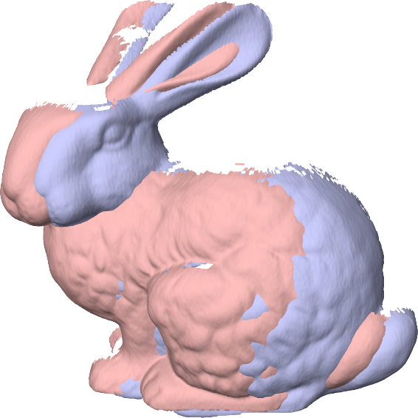
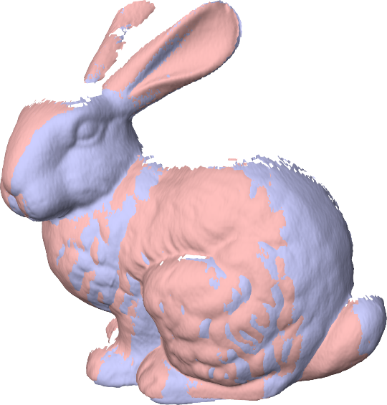
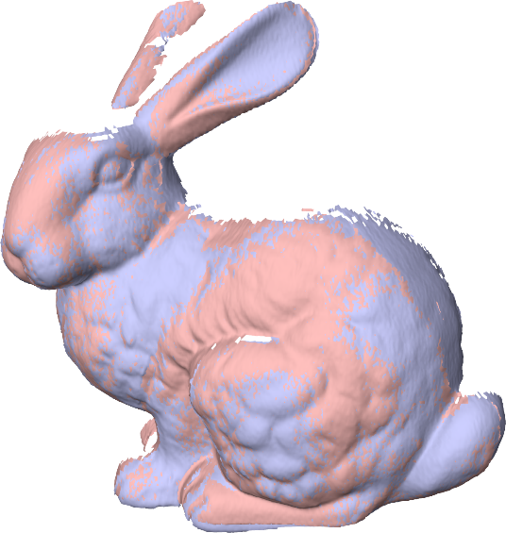
Effect of Different Metrics
Point-to-plane
Symmetric
Initial Alignment
Iteration #1
Iteration #2
Iteration #3
Notes:
What effect does this change have? Well now we’re comparing the symmetric metric to standard point to plane, and again we see a big improvement. After only 3 iterations, the bottom row has actually converged, whereas it’s going to take point to plane another 2 or 3 iterations to get there. So, we’ve made a seemingly trivial change, but it makes a big difference in how many iterations are required to get the right answer.

Slide 21
How do we speed up ICP? How well does the method work in general? Why does it work?
Notes:
So that was anecdotal evidence of how well the symmetric formulation works, but let’s look at a set of experiments that test it more thoroughly.

Slide 22
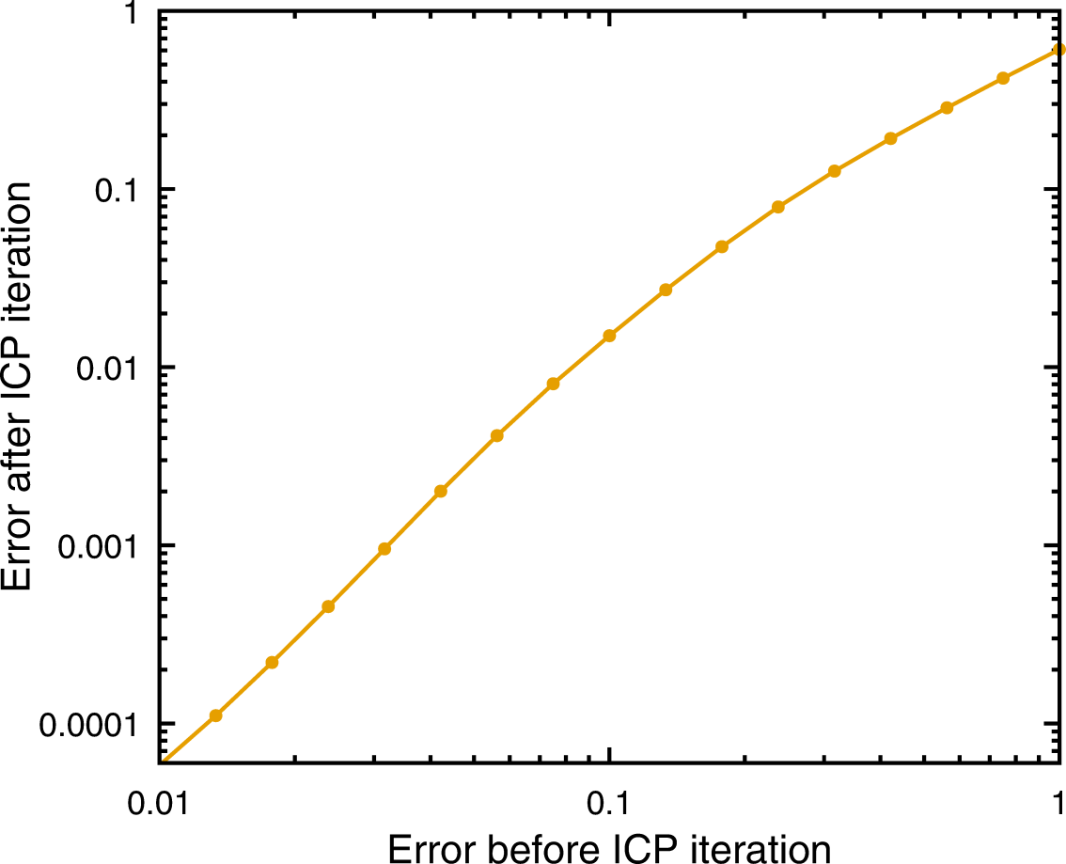
Evaluation: Convergence Rate
RMS ground-truth distance before and after 1 iteration
Lower is better
Note log-log scale!
Slope = convergence rate
Notes:
The first set of experiments we’re going to look at are evaluations of how much closer a single iteration brings us to the correct answer, evaluated as RMS distance of points to their ground-truth locations. We’re going to be looking at a bunch of graphs that look like this, where you take a number on the x axis representing how far away we were before the iteration, and look up on the y axis what the error is after ICP. So in this case an error of 0.1 got reduced to 0.015, meaning that an iteration got you about 6 times closer to the right answer. And this is averaged over 1000 initial poses all having that 0.1 initial RMS error. So, obviously lower is going to be better in these graphs, and also note that they’re plotted on a log-log scale, so that they show a big range of alignments from far away to pretty close. Incidentally, on these log-log plots, the slope of the curve indicates the convergence rate, so that a slope of 1 means linear convergence and so on.

Slide 23
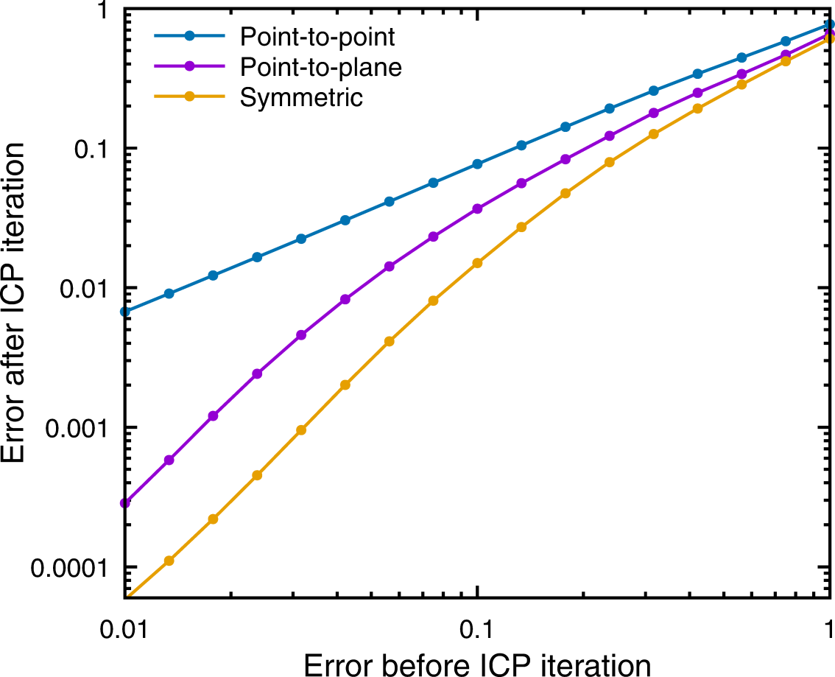
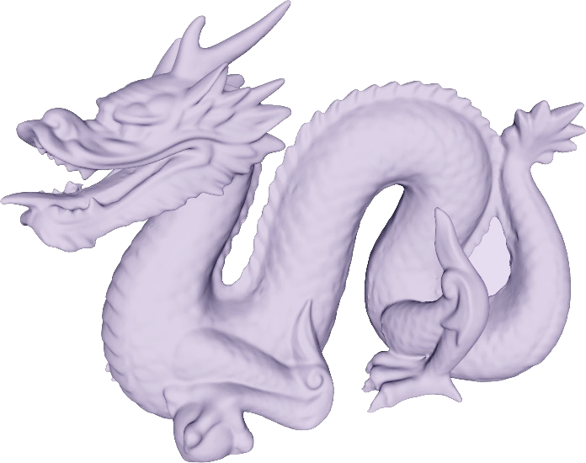
Evaluation: Convergence Rate
RMS ground-truth distance before and after 1 iteration
Lower is better
Note log-log scale!
Aligning dragon to itself…
Notes:
So now, here we are with a comparison of aligning two copies of the dragon mesh to itself. We can see that both point to plane, shown in purple, and the symmetric variant, shown in gold, converge much faster than point to point, shown in blue. But we also see that the symmetric ICP is doing almost an order of magnitude better per iteration than point to plane. So, we expect it to converge much, much faster once it gets anywhere close to the correct alignment.

Slide 24
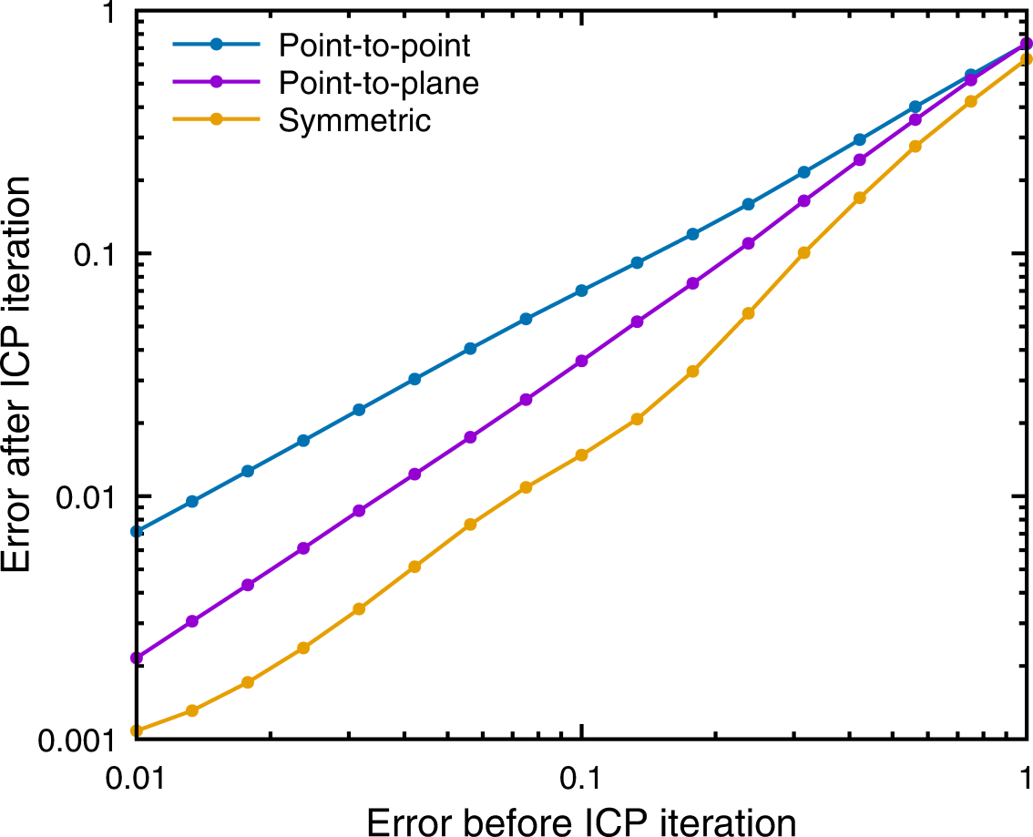
Evaluation: Convergence Rate
RMS ground-truth distance before and after 1 iteration
Lower is better
Note log-log scale!
Aligning bun090 to bun000…
Notes:
Here’s a tougher case involving partially overlapping scans. In this case, the performance is heavily influenced by other stages of ICP, such as outlier rejection, which is responsible for making sure we only have correspondences in the overlapping region. Still, we’re doing a factor of 2 better, per iteration, than point to plane.

Slide 25
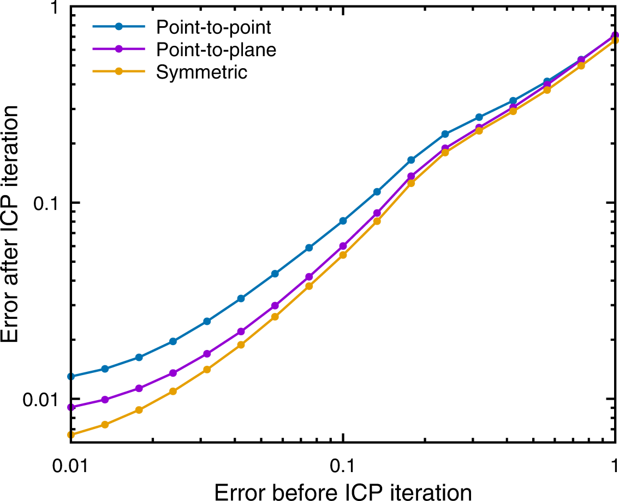
Evaluation: Convergence Rate
RMS ground-truth distance before and after 1 iteration
Lower is better
Note log-log scale!
Aligning TUM RGB-D scans…
Notes:
Here’s a particularly tough case of two RGB-D scans that have relatively little overlap, a lot of noise, and a lot of planar surfaces that should be particularly favorable for point to plane. You can see that the differences between variants are compressed, but still the symmetric error metric is doing better than the others.

Slide 26
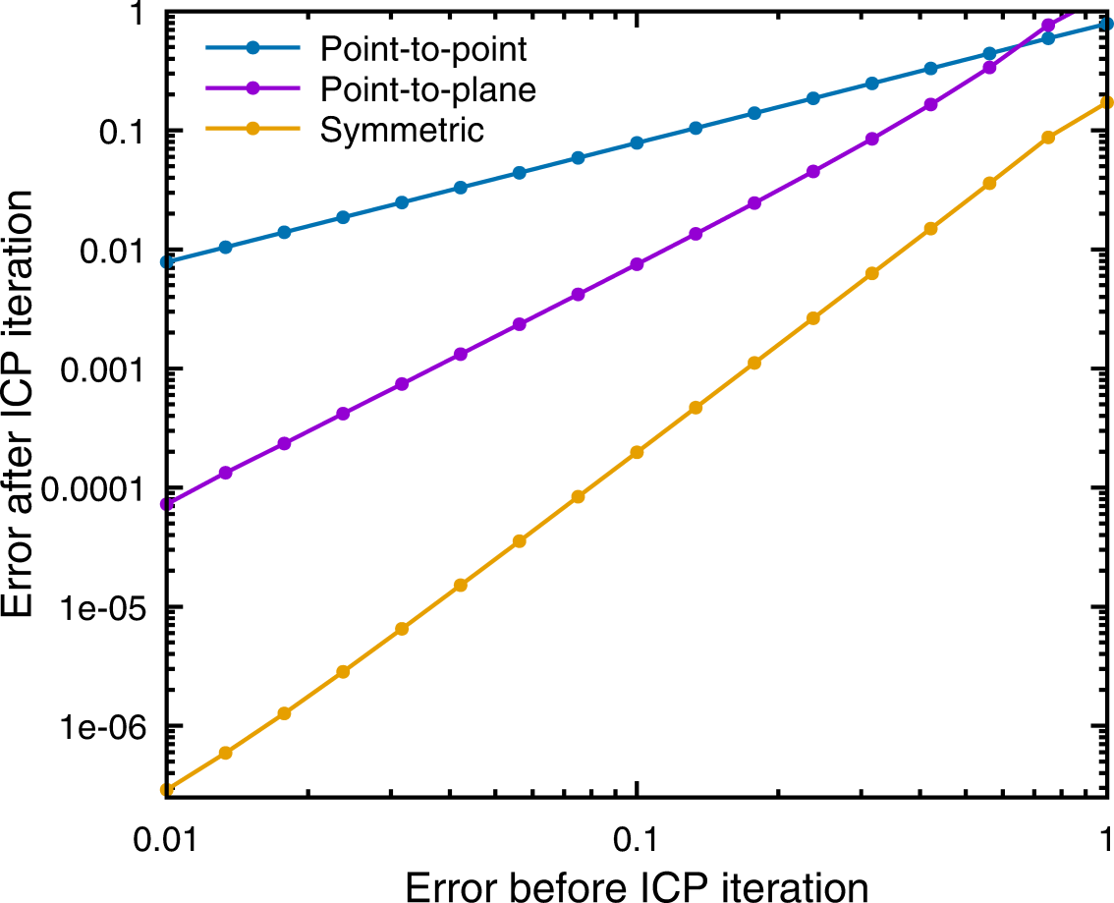
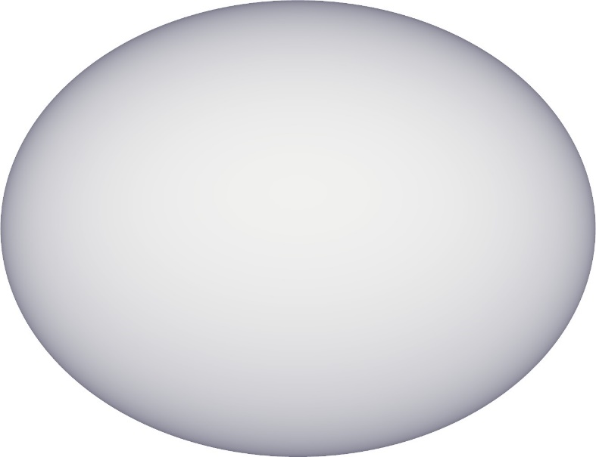
Evaluation: Convergence Rate
RMS ground-truth distance before and after 1 iteration
Lower is better
Note log-log scale!
Aligning ellipsoid to itself…
Notes:
If that was a worst-case scenario, here’s a best-case scenario for symmetric – aligning an ellipsoid to itself (and this actually isn’t in the paper). You can see a really dramatic difference in the slopes here: point to point has linear convergence, point to plane is quadratic, and the symmetric metric actually exhibits cubic convergence, so at each iteration the previous error is cubed, and gets small really fast.

Slide 27
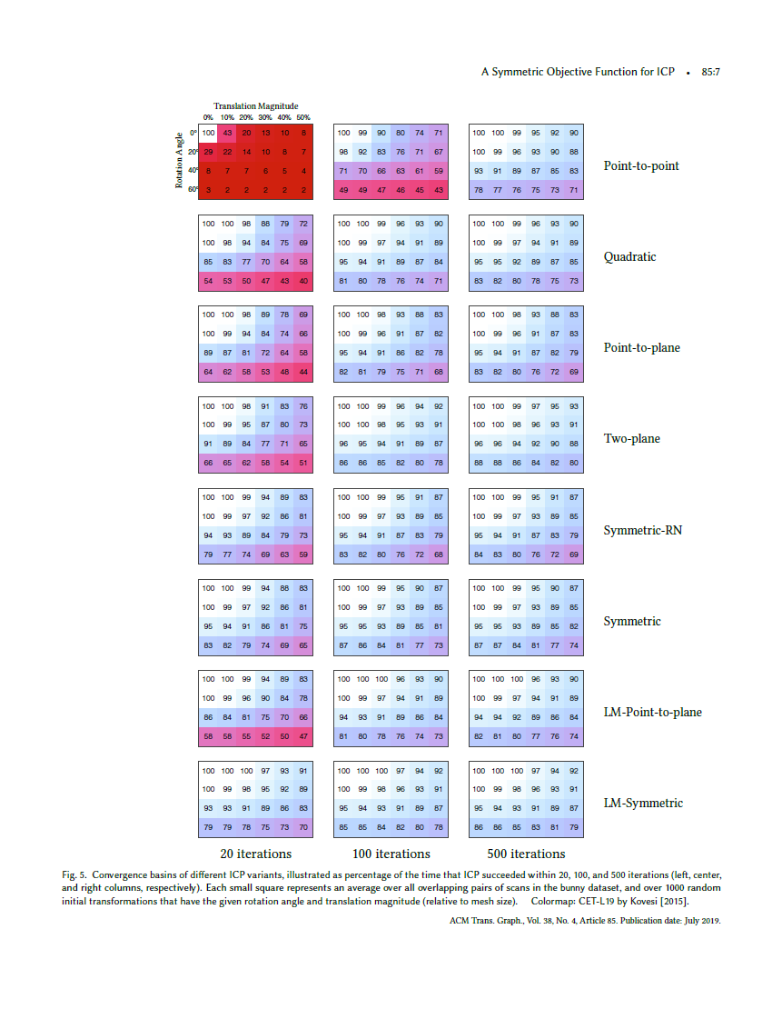
Evaluation: Convergence Basin
Success % in k iterations, across all overlapping pairs of bunny scans
Notes:
Here’s another way of evaluating the different metrics: seeing what fraction of the time ICP converges within a certain number of iterations. In the paper there are lots and lots of tables, but for this talk let me just give you the executive summary.

Slide 28
Evaluation: Convergence Basin
Success % in 500 iterations, across all overlapping pairs of bunny scans, averaged across starting alignments
Point-to-point | 88.3%
Point-to-plane | 87.8%
Symmetric | 90.1%
Notes:
If we consider 500 iterations, by which point any method that was going to converge has converged, and average across all starting misalignments, we get these numbers. The punch line isn’t so much that the symmetric variant is doing a lot better, but rather that it’s not sacrificing the size of the convergence basin for speed.

Slide 29
How do we speed up ICP? How well does the method work in general? Why does it work?
Notes:
Now, it’s one thing to provide empirical evidence that the symmetric variant works better, but let’s try to understand why such a small tweak makes such a big difference.

Slide 30
Understanding ICP
Expectation Maximization: alternating discrete/continuous optimization
Minimizing squared Euclidean distance, evaluated on other surface
Analyzing (per-point-pair) zero-set of metric
Notes:
Over the years, people have proposed a variety of ways of trying to understand the performance of ICP and its variants. The framework of Expectation Maximization allows you to prove that error decreases at each iteration, and the continuous part of the problem can be thought of in terms of Euclidean distance function minimization. But here we’re going to look at it in a different way, namely by asking under what sets of transformations does the error metric at a single point pair go to zero.

Slide 31
Zero-Set of Metric Determines Allowable “Sliding”
Bump at top has a hard time pulling meshes across each other: springs prevent sliding
Point-to-point
Pairs in flat section do not constrain up-and-down motion
Initial Alignment
Point-to-plane
Notes:
This is an interesting way of thinking about the problem, because it provides a very intuitive explanation of why point to plane works better than point to point. Consider these two scans, which each have a flat section and a bump on the top. Now the only thing that’s going to pull these two meshes into alignment in the up-and-down direction is that bump. But imagine the point to point case, where we have a bunch of springs in that flat section: those springs are actually keeping the meshes from sliding along each other, preventing the good correspondences on the bump from doing what they need to do. But in the point to plane case, those correspondences in the flat section do not constrain the sliding, because that’s in-plane motion and isn’t penalized by the error metric.

Slide 32
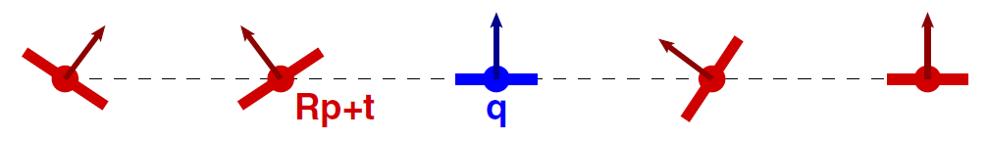
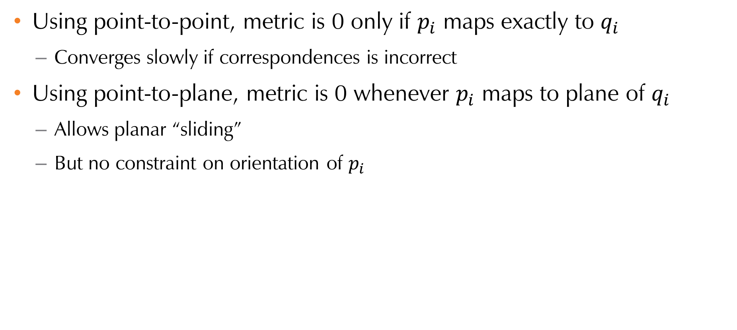
Zero-Set of Metric
Using point-to-point, metric is 0 only if $p_{i}$ maps exactly to $q_{i}$
Converges slowly if correspondences is incorrect
Using point-to-plane, metric is 0 whenever $p_{i}$ maps to plane of $q_{i}$
Allows planar “sliding”
But no constraint on orientation of $p_{i}$
Notes:
So, thinking explicitly about the zero sets of the point to point and point to plane metrics, under point to point the metric for a single pair is minimized only when the points are mapped exactly onto each other. On the other hand, point to plane has a wider allowable set of positions that all lead to the metric’s being zero, which allows for planar sliding, which in turn is good if the correspondences aren’t perfect. On the other hand, this only happens if the points are coplanar. And, point to plane does nothing to directly constrain the relative orientation of one scan relative to the other: all of these orientations of the red patch still lead to zero error.

Slide 33
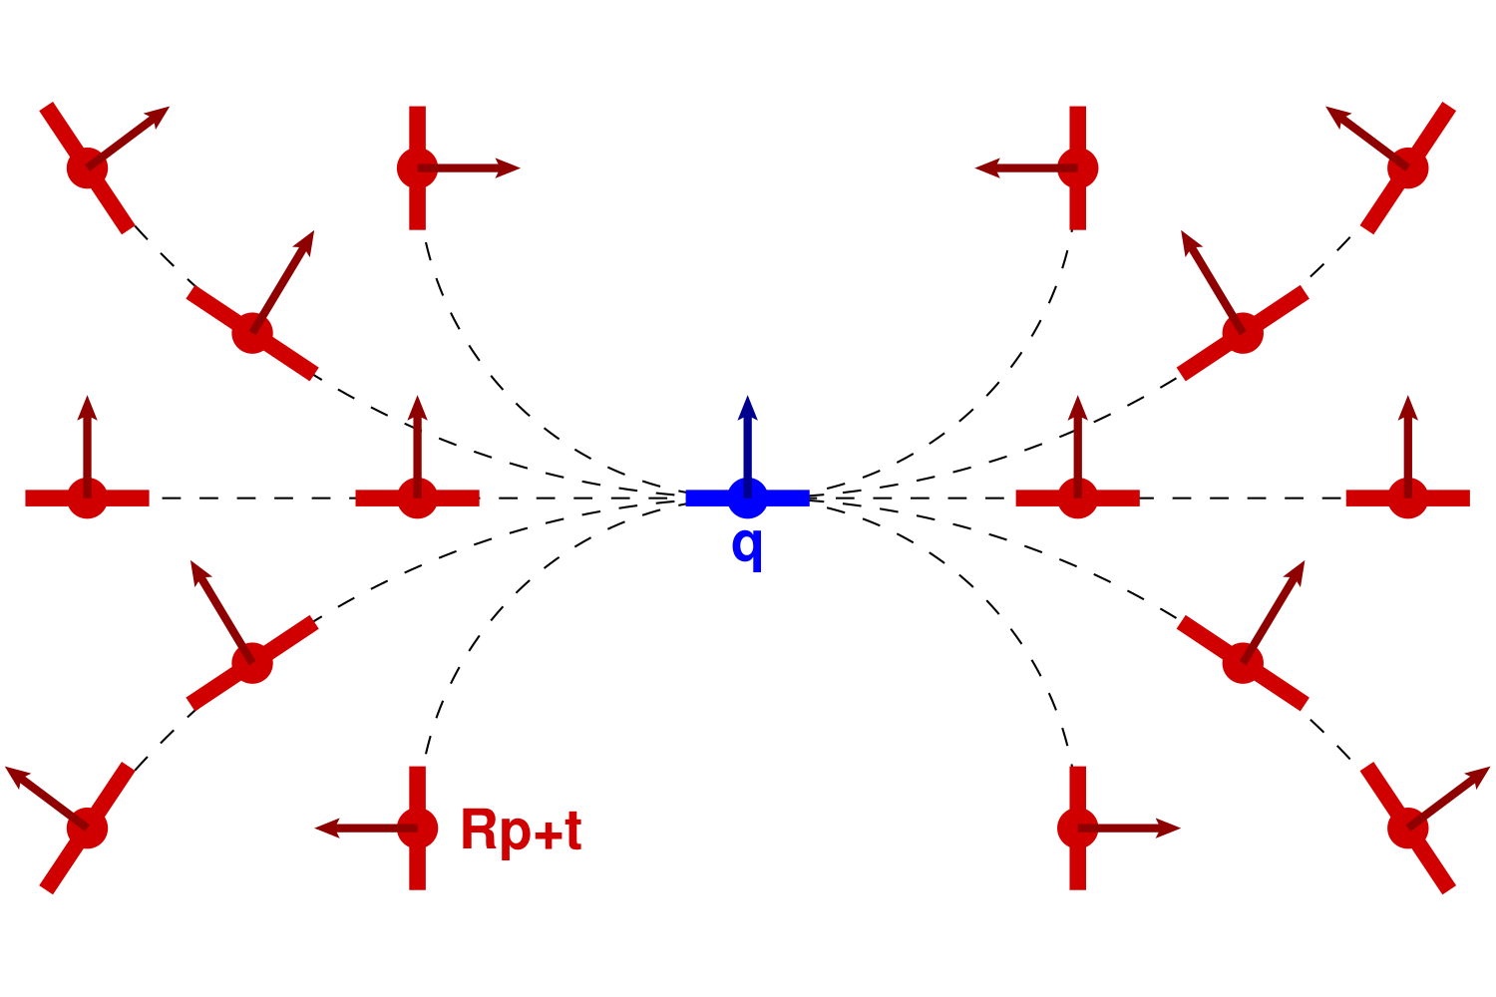
Zero-Set of Symmetric Metric
Using symmetric metric allows for more sliding!
Notes:
So now we come to the big deal: the symmetric metric actually allows for more sliding if the corresponding points are not coplanar. In fact, there are curved surfaces such that if the two points and both of their normals are consistent with that curved surface, the metric is exactly zero.

Slide 34
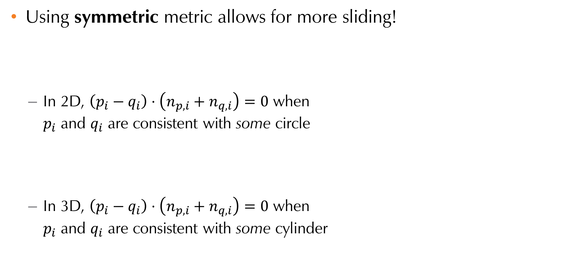
Zero-Set of Symmetric Metric
Using symmetric metric allows for more sliding!
In 2D, $\left(p_{i}−q_{i}\right)⋅\left(n_{p,i}+n_{q,i}\right)=0$ when $p_{i}$ and $q_{i}$ are consistent with some circle
In 3D, $\left(p_{i}−q_{i}\right)⋅\left(n_{p,i}+n_{q,i}\right)=0$ when $p_{i}$ and $q_{i}$ are consistent with some cylinder
Notes:
What are those curved surfaces? Well, in 2D they’re just circles, and the metric is zero if the two points and their normals are consistent with some circle. The equivalent in 3D is cylinders, but that’s kind of hard to think of and hard to visualize, so let me give you an alternative way of thinking about the 3D case.

Slide 35
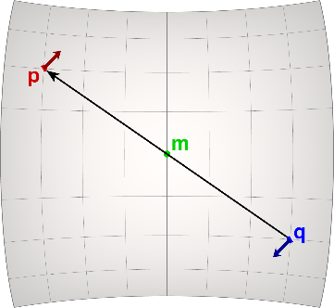
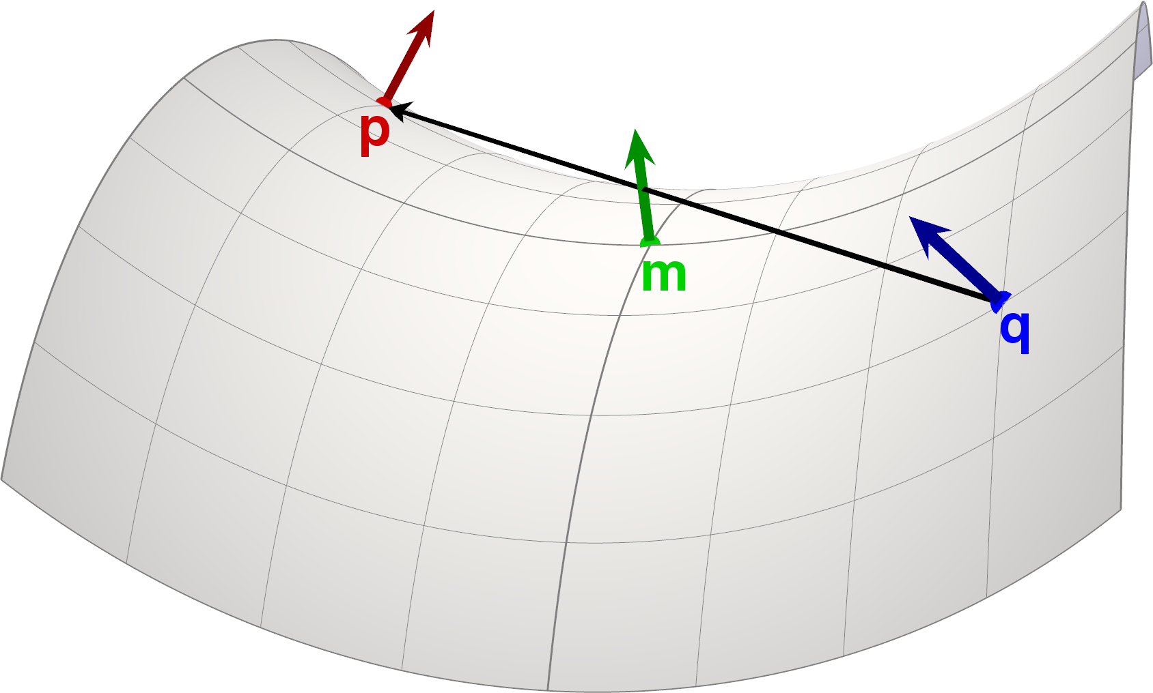
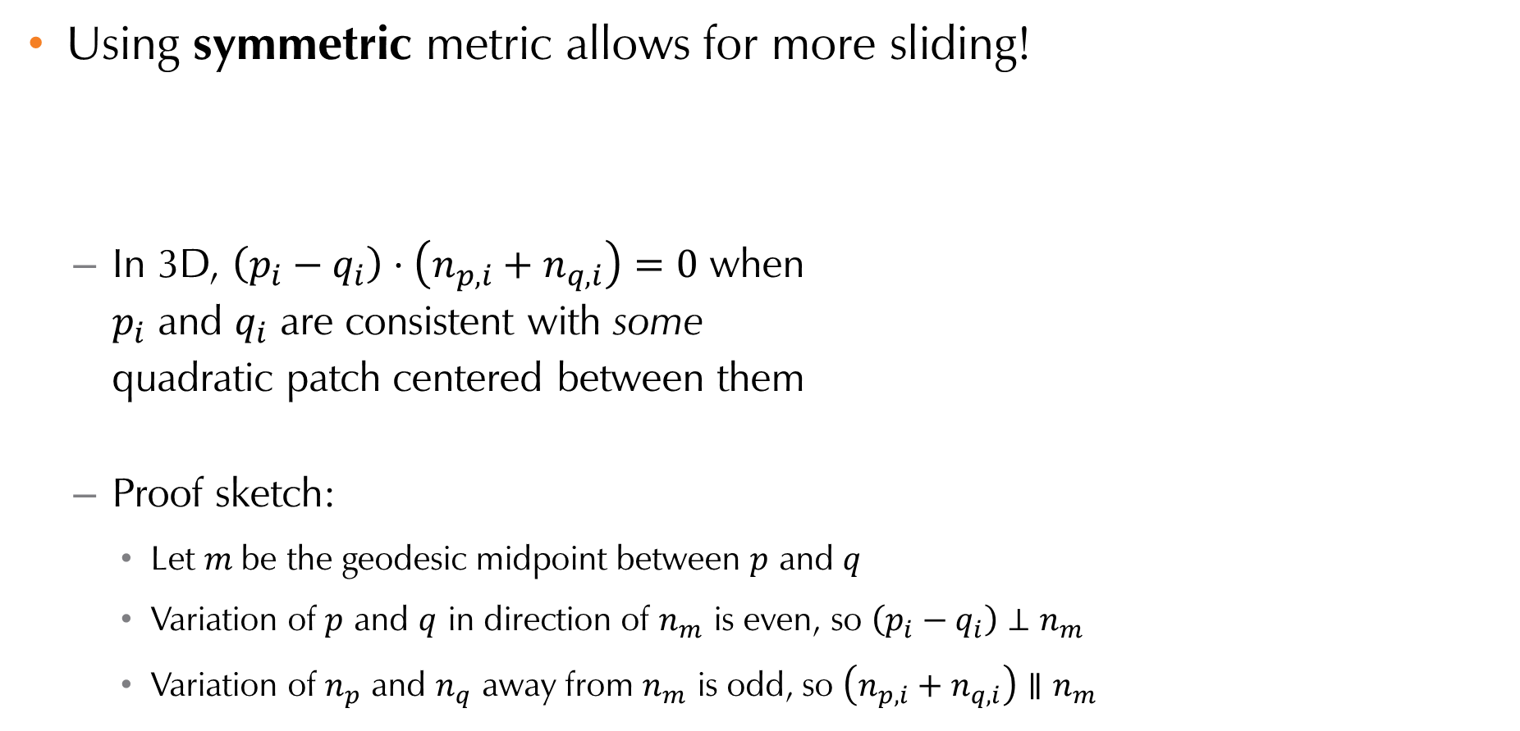
Zero-Set of Symmetric Metric
Using symmetric metric allows for more sliding!
In 3D, $\left(p_{i}−q_{i}\right)⋅\left(n_{p,i}+n_{q,i}\right)=0$ when $p_{i}$ and $q_{i}$ are consistent with some quadratic patch centered between them
Proof sketch:
Let $m$be the geodesic midpoint between $p$ and $q$
Variation of $p$ and $q$ in direction of $n_{m}$ is even, so $\left(p_{i}−q_{i}\right)⊥n_{m}$
Variation of $n_{p}$ and $n_{q}$ away from $n_{m}$ is odd, so $\left(n_{p,i}+n_{q,i}\right)∥n_{m}$
Top view
Side view
Notes:
It turns out that the metric in 3D is zero as long as there’s a quadratic patch centered between the points, and both the points and normals are consistent with that quadratic patch. To give you just a very quick sketch of a proof, the “height” of the two points is an even function relative to the midpoint m, so p-q is perpendicular to that green arrow. The variation of the normals is an odd function, so the sum of normals is parallel to that green arrow. In the end, p-q is perpendicular to np + nq, so their dot product is zero.

Slide 36
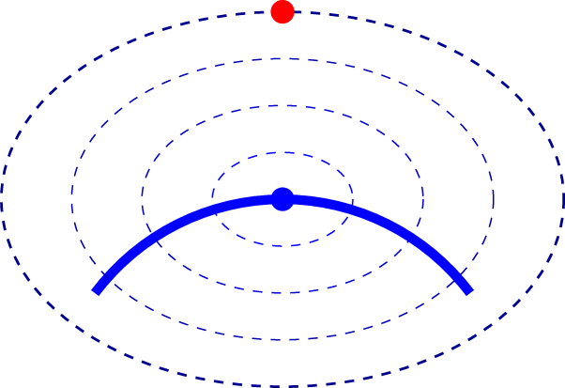
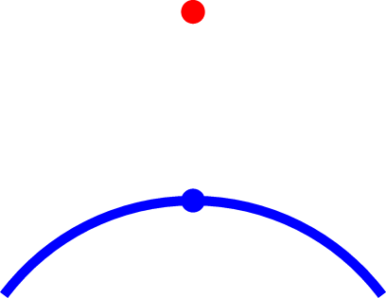
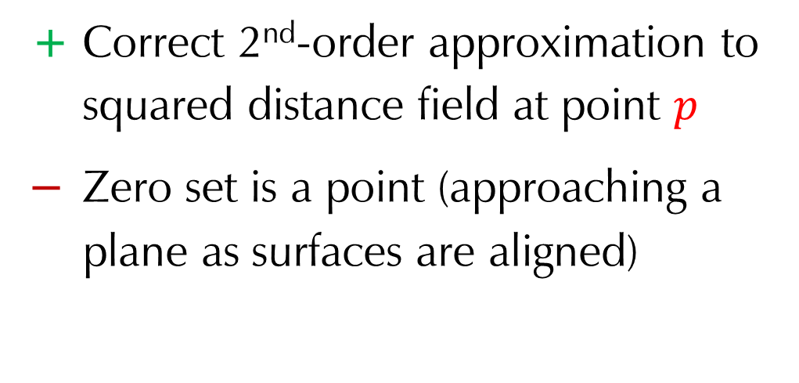
Compared to Quadratic Minimization
Work by [Mitra, Gelfand, Pottmann, Guibas 2004] minimizes quadratic approximant to squared distance function
+ Correct 2nd-order approximation to squared distance field at point $p$
− Zero set is a point (approaching a plane as surfaces are aligned)
Notes:
So now let’s use the zero-set methodology to look at some previous work. First we look at the method of Mitra et al., which actually directly forms a quadratic approximation to the squared distance function. So given this red point and the blue surface, it will evaluate the curvature of the blue surface, and then construct a second-order function, illustrated here by these elliptical level sets, such that by the time you get out to the red point the function is a 2nd order approximation to the squared distance field of the blue surface. But here’s the problem: the function is correct at that red point, but its zero set is still just a point, approaching a plane as you get closer to correctly aligned.

Slide 37
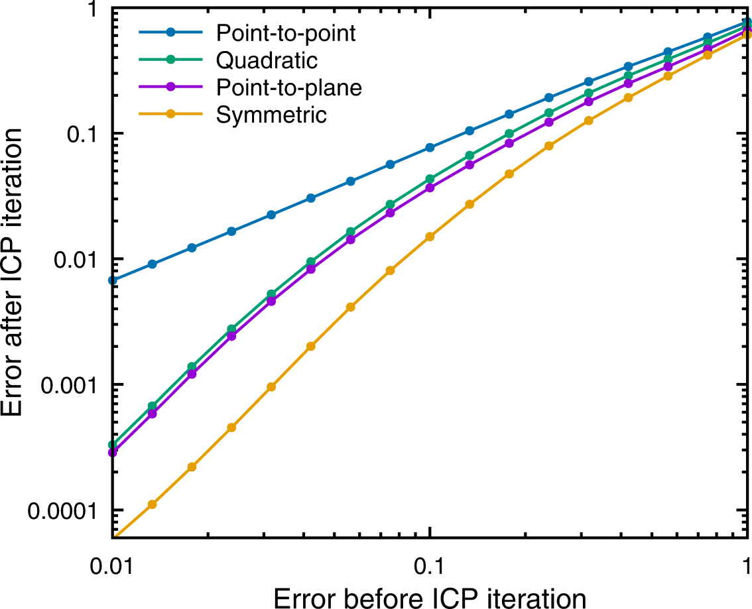
Evaluation: Convergence Rate
RMS ground-truth distance before and after 1 iteration
Lower is better
Note log-log scale!
Aligning dragon to itself…
Notes:
So, we can see that its convergence performance, which is the green line in this graph, is somewhere between point to point and point to plane. In particular, as you get closer and closer to aligned, it’s basically doing the same as point to plane.

Slide 38
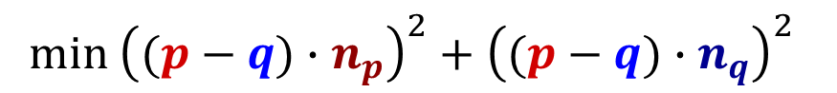
Compared to Two-Plane Minimization
Work by [Tagliasacchi et al. 2015] and others minimizes sum of squared distances to both planes:
+ Related to Hausdorff distance
− Zero set is more restrictive than point to plane
$$\min{{\left((p−q)∙n_{p}\right)}^{2}+{\left((p−q)∙n_{q}\right)}^{2}}$$
Notes:
Here’s another comparison, this time to a two-plane metric that minimizes the sum of squared distances to planes defined by both normals. On the plus side, this has a nice relationship to minimizing the Hausdorff distance between the surfaces. However, it has a more restrictive zero set than point to single plane…

Slide 39

Evaluation: Convergence Rate
RMS ground-truth distance before and after 1 iteration
Lower is better
Note log-log scale!
Aligning bun090 to bun000…
Notes:
… so it does about as well in terms of convergence as point to single plane, sometimes a bit better, sometimes a bit worse. (It’s the red curve in this graph.)

Slide 40
Recap
Symmetric metric
Zero if point pair consistent with 2nd-order surface
Allows more “sliding”
Fast optimization
Wide convergence basin
Minimal extra cost
Notes:
So, to recap, the symmetric metric is zero whenever a point pair is consistent with some 2nd order surface … so it allows for more flexible sliding, letting surface features pull the meshes into alignment … which leads to faster optimization and a wide convergence basin … all at minimal additional computational cost.
I think it’s a good idea, and ICP implementations should consider using it.

Slide 41
Thanks To…
Maciej Halber and the entire PIXL group
Misha Kazhdan
Maps and 3D scanning groups at Google (Visiting Faculty program)
NSF grants IIS-1421435, CHS-1617236, and IIS-1815070
Code at trimesh2.cs.princeton.edu
Thank You for your Attention!

Slide 43

Evaluation: Convergence Rate
Aligning dragon to itself…

Slide 44

Evaluation: Convergence Rate
Aligning bun090 to bun000…

Slide 45

Evaluation: Convergence Rate
Aligning TUM RGB-D scans…

Slide 46



Evaluation: Convergence Basin
Success % in 20 iterations, across all overlapping pairs of bunny scans
Translation
Rotation
Point to point
Point to plane
Symmetric
Notes:
Here’s another way of evaluating the different metrics: seeing what fraction of the time ICP converges within a certain number of iterations. Here we have tables that show how often ICP has converged within 20 iterations, given a particular starting translation and rotation. At 20 iterations, point to point has basically never converged for larger initial misalignments, and symmetric is doing quite a bit better than point to plane.

Slide 47



Evaluation: Convergence Basin
Success % in 500 iterations, across all overlapping pairs of bunny scans
Translation
Rotation
Point to point
Point to plane
Symmetric
Notes:
Here we show 500 iterations, meaning that if ICP was going to converge, it should have done so by now. You can see that the convergence basin is strictly wider for symmetric than for point to plane, and most of the time is doing better than point to point. The paper has a bunch of additional comparisons to other variants, and basically the symmetric metric is either winning or very competitive relative to all of them.

